Slide 1
Sequential Search

Slide 2
Sequential Search
Sequential Search
Implementation of Sequential Search
Analysis on Unordered List
Analysis on Ordered List

Slide 3

Sequential Search
Basic searching technique, sequentially go through the data structure, comparing elements as you go along.
For example, on an unordered list searching for the element 50:

Slide 4
Sequential Search
50 was not present, but we still had to check every element in the array.
But what if it was ordered?

Slide 5

Sequential Search
If the list is ordered, we know we only have search until we reach an element which is a match or we reach an element which is greater than our search target.
For example, searching for 50, we can stop here at 54.

Slide 6
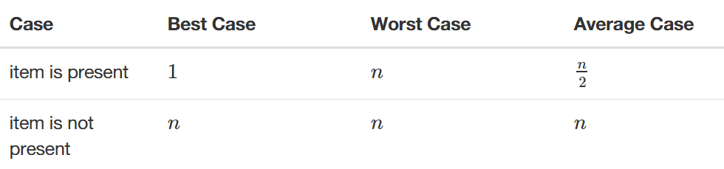
Sequential Search Analysis
Unordered List Analysis

Slide 7
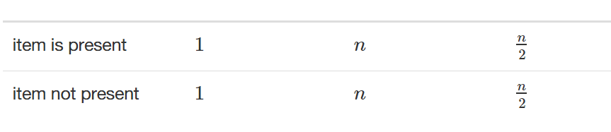
Sequential Search Analysis
Ordered List Analysis

Slide 8
Sequential Search Implementation
Let’s do some basic implementations of Sequential Search!
We’ll do both Ordered and Unordered implementations!

